Slide 1

Big Data Processing
INF583 - Systems for Big Data
Ali Haidar - Maya Awada

Slide 2
Outline
Part A - Operations on List of Integers
A1 - Largest Integer
A2 - Average Integer
A3 - Set of Distinct Integers
A4 - Number of Distinct Integers
Part B - Ranking Wikipedia Web Pages
Eigenvector Centrality Implementation
- Apache Hadoop
- Apache Spark
- Threads
- Performance Comparison
- Most Important Wikipedia Page
Matrix-Multiplication using 1 MapReduce
Computational Cost

Slide 3
Part A - Operations on List of Integers
Implementation in Apache Spark
Implementation in Apache Hadoop
Implementation in Spark Streaming
Algorithm | Output
Largest Integer | 100
Average Integer | 51.067
Set of Distinct Integers | 1, 2,.., 99, 100
Number of Distinct Integers | 100

Slide 4
A1 - Largest Integer
Implementation in Apache Spark
Map phase: For each number, we create a pair (1, number)
Reduce phase: For each group of tuples (1,a) , (1,b) we reduce them to (1, max(a,b))
Implementation in Apache Hadoop
Map phase: For each number, we create a pair (1, number)
Reduce phase: Aggregate all the values to then loop over them and take the maximum value of each pair of values at a time.
Implementation in Spark Streaming
Apply the MapReduce job separately on each stream of data to get its largest integer value
Use a long accumulator that goes over these values and returns the maximum integer

Slide 5
A2 - Average Integer
Implementation in Apache Spark
Map phase: For each number, we create a pair (1, pair(number, 1))
Reduce phase: For each group of tuples (1,(a1,b1)) , (1,(a2,b2)) we reduce them to (1,(a1+a2, b1+b2))
Implementation in Apache Hadoop
Map phase: For each number, we create a pair (1, number)
Reduce Phase: Aggregate all the values to then loop over them and compute their sum and count
Implementation in Spark Streaming
Apply the MapReduce job separately on each stream of data to get its sum and count of elements
Use 2 long accumulators to compute the sum and count of all elements respectively

Slide 6
A3 - Set of Distinct Integers
Implementation in Apache Spark
Map phase: For each number, we create a pair (number, 0)
Reduce phase: For each group of tuples (a,0) , (a,0) we reduce them to (a,0)
Implementation in Apache Hadoop
Map phase: For each number, we create a pair (number, 1)
Reduce phase: For each key, aggregate all the values and keep the value 1 for each key as such: (number, 1)

Slide 7
A4 - Number of Distinct Integers
Implementation in Apache Spark
Map phase 1: For each number, we create a pair(number, 0)
Reduce phase 1: For each pair of tuples (a,0) , (a,0) we reduce them to (a,0)
Map phase 2: Map each (number,0) to (1,1)
Reduce phase 2: For each pair of tuples (1,a) , (1,b) we reduce them to (1,a+b)
Implementation in Apache Hadoop
Note: We use the output of exercise A3 as input to the mapper.
Map phase: Map each (number,0) to (1,1)
Reduce phase: Aggregate all the values to then loop over them and compute the count of values

Slide 8
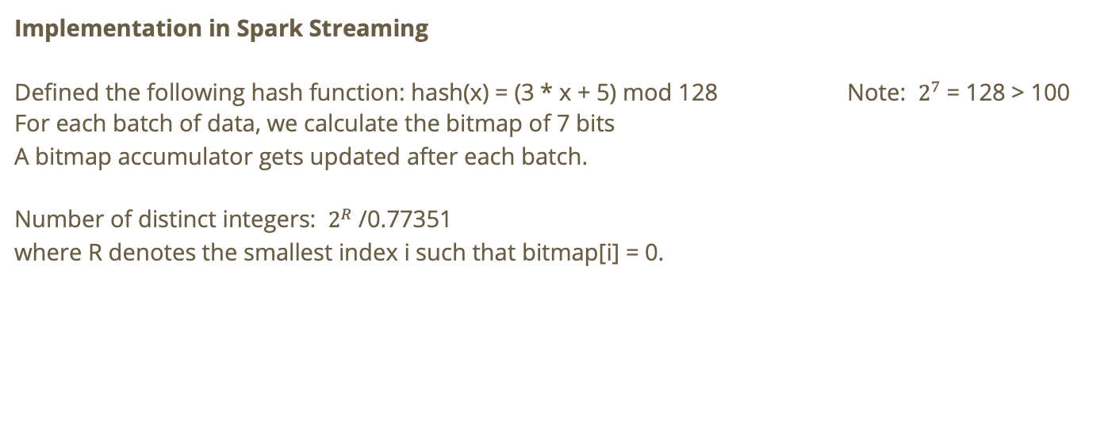
Flajolet–Martin Algorithm
Implementation in Spark Streaming
Defined the following hash function: hash(x) = (3 * x + 5) mod 128 Note: $2^{7}$= 128 > 100
For each batch of data, we calculate the bitmap of 7 bits
A bitmap accumulator gets updated after each batch.
Number of distinct integers: $2^{R}$/0.77351
where R denotes the smallest index i such that bitmap[i] = 0.

Slide 9
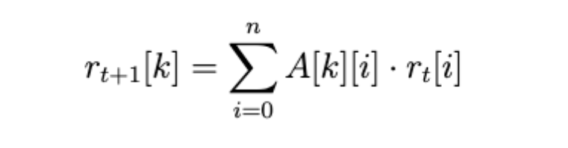
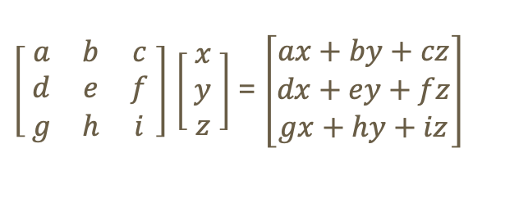



Part B - Ranking Wikipedia Web Pages
Eigenvector Centrality Implementation
Matrix-Vector Multiplication
$\left[ \begin{matrix}a & b & c \\ d & e & f \\ g & h & i\end{matrix} \right]$ $\left[\begin{matrix} x \\ y \\ z\end{matrix} \right]$ = $\left[\begin{matrix}ax+by+cz \\ dx+ey+fz \\ gx+hy+iz\end{matrix}\right]$
$$\text{A}$$
$$r^{t}$$
$$r^{t+1}$$

Slide 10
Part B - Ranking Wikipedia Web Pages
Eigenvector Centrality Implementation
Matrix-Vector Multiplication
$\left[ \begin{matrix}a & b & c \\ d & e & f \\ g & h & i\end{matrix} \right]$ $\left[\begin{matrix} x \\ y \\ z\end{matrix} \right]$ = $\left[\begin{matrix}ax+by+cz \\ dx+ey+fz \\ gx+hy+iz\end{matrix}\right]$
$$\text{A}$$
$$r^{t}$$
$$r^{t+1}$$
We are therefore interested in grouping all elements having the same $i$.

Slide 11

Implementation in Apache Hadoop
Assumption
The eigenvector $r^{t}$ is saved in a text file under the format:
0 r[0]
1 r[1]
2 r[2]
..
N r[n]

Slide 12
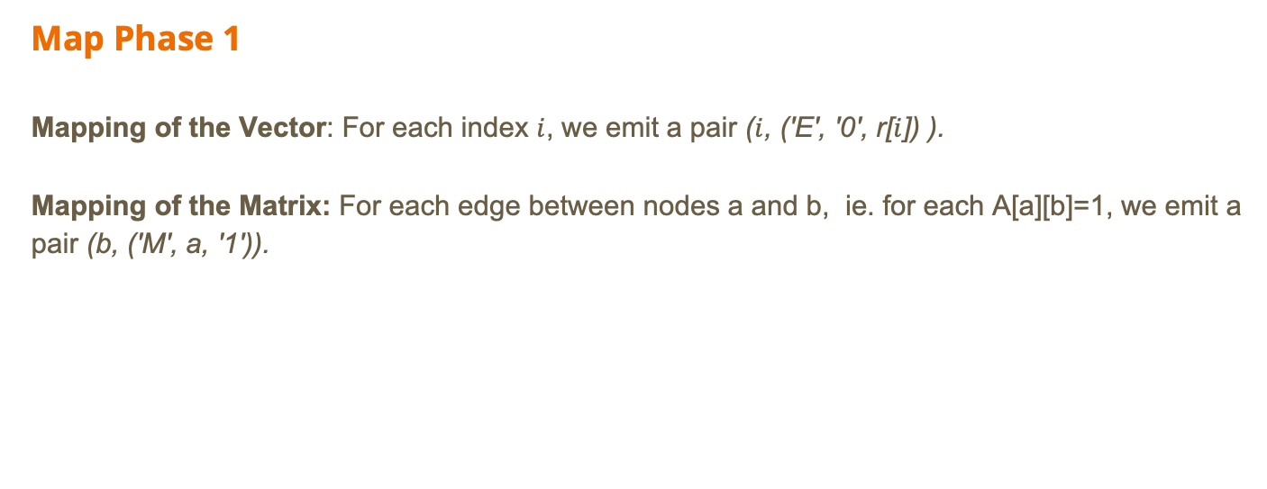
Implementation in Apache Hadoop
Map Phase 1
Mapping of the Vector: For each index $i$, we emit a pair ($i$, ('E', '0', r[$i$]) ).
Mapping of the Matrix: For each edge between nodes a and b, ie. for each A[a][b]=1, we emit a pair (b, ('M', a, '1')).

Slide 13
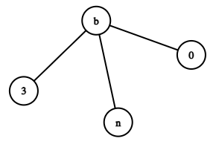
Implementation in Apache Hadoop
Reduce Phase 1
For each key, aggregate all the values and add them to a list. Each list contains one value coming from the mapping of the vector and a number of values coming from the mapping of the matrix.
(b, ((E,0,r[b]), (M,0,1), (M,3,1), (M,n,1)))
Sorted list of values
(0, r[b])
(3, r[b])
(n, r[b])
Then, for each tuple (M, i, 1) coming from the matrix, we emit a pair (i, r[b]):

Slide 14
Implementation in Apache Hadoop
Map Phase 2
We read the output of the last reducer and we emit (key,val).
Reduce Phase 2
For each key, we sum the values and we emit (i, sum(values)).

Slide 15
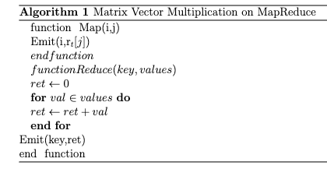
Implementation in Apache Spark
Map Phase
For each edge between nodes
i and j, we emit a pair (i, r[j]).
Reduce Phase
For each key i, which represents a row in A, we sum all the values.
→ ie. we sum all values that share the same row number.
Assumption: Vector $r^{t}$is represented as an array in Java

Slide 16

Implementation in Threads
Divide the matrix into 4 different parts
Perform the calculation over these 4 threads at the same time
Calculate the elements of the resulting vector shared between all threads

Slide 17
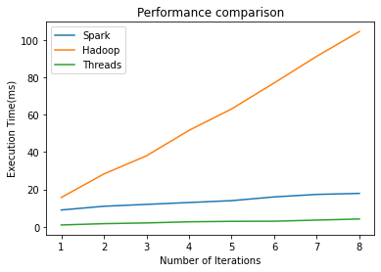
Performance Comparison

Slide 18

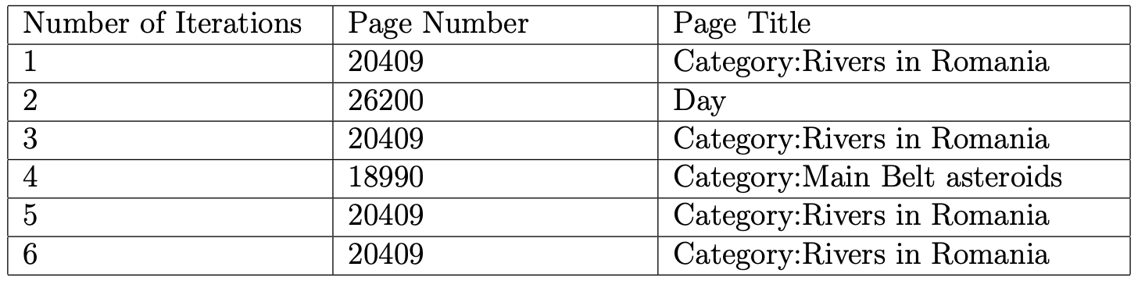
Most Important Wikipedia Page
Overall: ‘Category: Rivers in Romania’

Slide 19
Matrix-Multiplication using 1 MapReduce Step
Map Phase
Mapping of Matrix A: (key, value)=((i, k), (A, j, Aij)) for all k
Mapping of Matrix B: (key, value)=((i, k), (B, j, Bjk)) for all i
Reduce Phase
For each key, we generate 2 sorted lists: Alist and Blist.
We then compute the summation (Aij * Bjk) for each key and output ((i, k), sum)

Slide 20
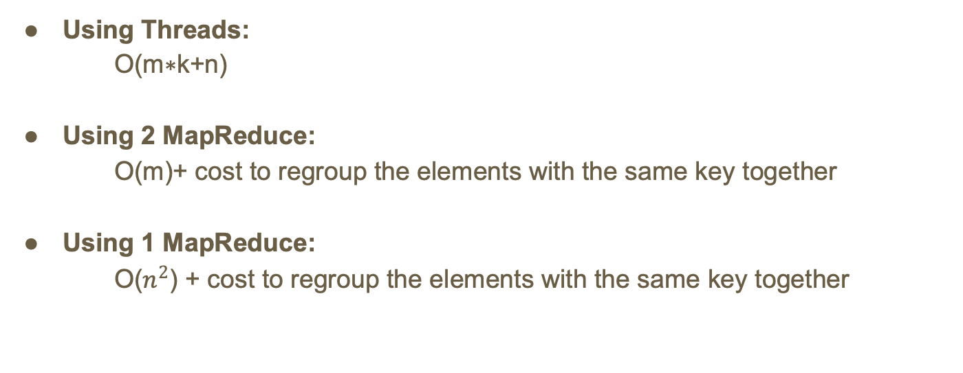
Computational Cost
m = number of edges,
k = number of iterations
n = number of nodes
Using Threads:
O(m∗k+n)
Using 2 MapReduce:
O(m)+ cost to regroup the elements with the same key together
Using 1 MapReduce:
O($n^{2}$) + cost to regroup the elements with the same key together

Slide 21
Thank you!

